Slide 1
CHAPTER 7: SORTING
BIBHA STHAPIT
ASST. PROFESSOR
IoE, PULCHOWK CAMPUS

Slide 2
Introduction
Arrangement of data in some systematic order is called sorting
Sorting can be done based on some key reference
The key reference can be numbers, alphabets etc.
Sorting is essential part of data management, since it helps in searching the data
Sorting can be done in two different orders:
Ascending Order (Increasing Order)
DI ≤ D2 ≤ D3 ≤ ……. ≤ Dn
Descending Order (Decreasing Order)
DI ≥ D2 ≥ D3 ≥ ……. ≥ Dn
2,5,4,1,8,6 => Unsorted Data
1,2,4,5,6,8 => Sorted Data (Ascending Order)
8,6,5,4,2,1 => Sorted Data (Descending Order)

Slide 3
Types of sorting
Sorting can be categorized into different categories:
1. Internal and external sorting
Internal Sorting
The sorting done within the computer main memory is called internal sorting
It is performed on data items small enough to easily fit within the main memory
External Sorting
The sorting is done in external file disk, i.e. secondary memory
It is performed if the data to be sorted does not fit within computer main memory

Slide 4
Types of sorting
2. In-place and non-in-place sorting
In-place sorting
Sorting can be done within array itself
E.g. Bubble sort
Non-in-place sorting
It requires more space/array (more than or equal to number of elements)
E.g. Merge sort

Slide 5
Types of sorting
3 . Stable and not-stable sorting
Stable sorting
After sorting, if it doesn’t change the sequence of similar content in which they appear.
Not-stable sorting
After sorting, if it changes the sequence of similar content in which they appear.
10
3
3
6
8
3
3
6
8
10
10
3
3
6
8
3
3
6
8
10
Stable
Not-Stable

Slide 6
Types of sorting
4. Adaptive and Non-adaptive sorting
Adaptive sorting
Takes advantage of already sorted elements
Will not try to re-order the previous list
Non-adaptive sorting
Forces every single element to be reordered to confirm their sortedness

Slide 7
Sorting Efficiency
Different sorting algorithms are known
Choice of the correct sorting algorithm based on the requirement and data items to be sorted
Efficiency of the algorithms depend upon mainly two factors
Time Complexity:
Amount of machine time the algorithm takes to sort the data
Depends mainly upon numbers of comparisons and number of moves
Space Complexity:
Amount of memory space required by the program during sorting
Depends mainly upon the programming code for the algorithm and working space required by the program during calculations

Slide 8
Sorting Algorithms
Some algorithms to be discussed in this chapter are:
Bubble Sort
Quick Sort
Selection Sort
Insertion Sort
Shell Sort
Heap Sort
Merge Sort
Radix Sort

Slide 9
Bubble Sort
a simple sorting algorithm which
repeatedly steps through the list to be sorted
compares each pair of adjacent items
swaps them if they are in the wrong order
The passing through the list is continued until the swapping is not required (i.e. the list sorted)
it is a comparison sort
It is called Bubble Sort because the data gradually bubbles up in its proper position
In each pass at least one data is bubbled up in its proper position

Slide 10
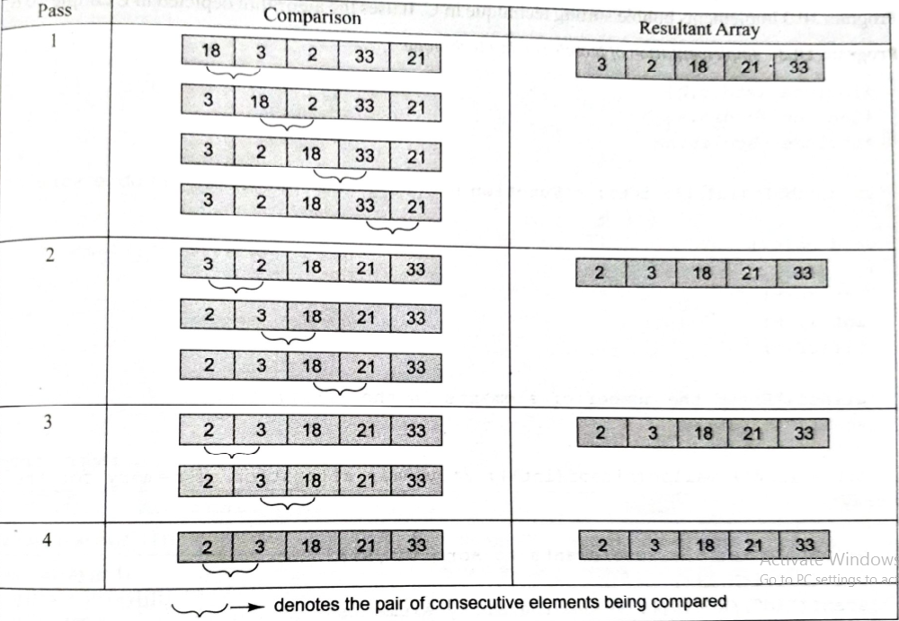
Bubble sort

Slide 11

Bubble Sort

Slide 12
Bubble Sort (Algorithm-pseudocode)
Declare and Initialize necessary variables
n => number of data items
a[n] => an array holding all the data items to be sorted
BUBBLE_SORT(A, N)
Step 1: Repeat Step 2 For I = 0 to N-1
Step 2: Repeat For J = 0 to N-I
Step 3: IF A[J] > A[J + 1] // for ascending order
SWAP A[J] and A[J+1]
[END OF INNER LOOP]
[END OF OUTER LOOP]
Step 4: EXIT

Slide 13
Selection Sort
One of the simplest algorithm
In each pass the smallest/largest value is selected and placed as the leftmost data item
Now the selection is done discarding the value just selected and thus selected new data is placed as the second leftmost one
The list on the left side thus is the sorted list and the one in right side is the unsorted one
A list of n elements requires n-1 passes to completely rearrange the data
The last pass requires only one comparison between the last two elements remaining

Slide 14
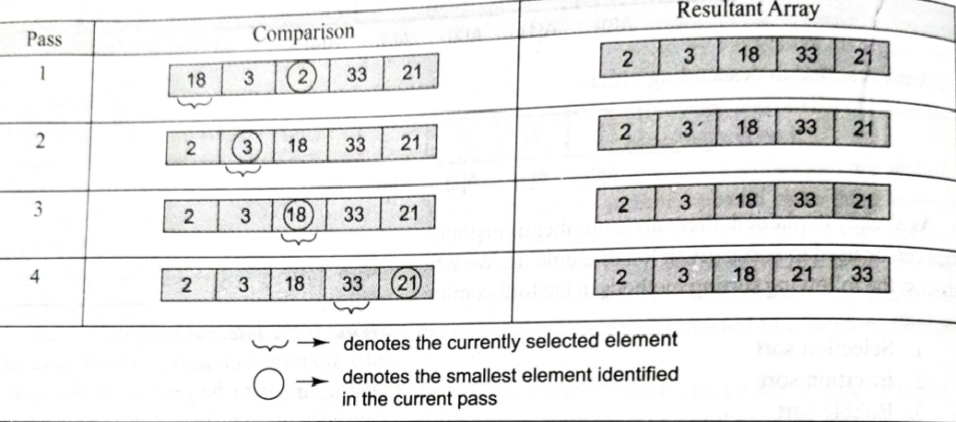
Selection sort

Slide 15
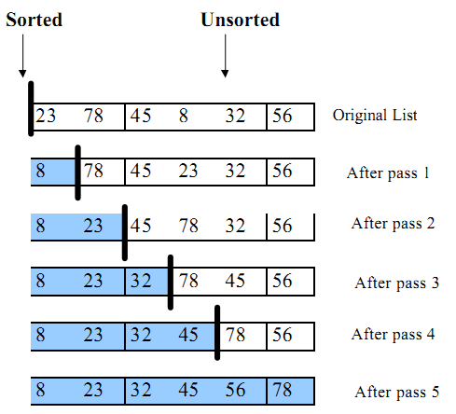
Selection Sort
Consider an example:
23 78 45 8 32 56 (six numbers, five passes required)

Slide 16
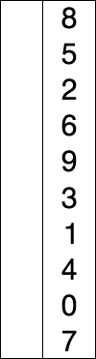
Selection Sort
Legend:
Red: Current Minimum
Yellow: Sorted Items
Blue: Current Item

Slide 17
Selection Sort (Algorithm-pseudocode)
SELECTION_SORT(ARR, N)
Step 1: Repeat Steps 2 and 3 for K=1 to N-1
Step 2: CALL SMALLEST(ARR, K, N, POS)
Step 3: SWAP ARR[K] with ARR[POS]
[END OF LOOP]
Step 4: EXIT
SMALLEST (ARR, K, N, POS)
Step 1: [INITIALIZE] SET SMALL = ARR[K]
Step 2: [INITIALIZE] SET POS = K
Step 3: Repeat for J = K+1 to N
IF SMALL > ARR[J]
SET SMALL = ARR[J]
SET POS = J
[END OF IF]
[END OF LOOP]
Step 4: RETURN POS

Slide 18
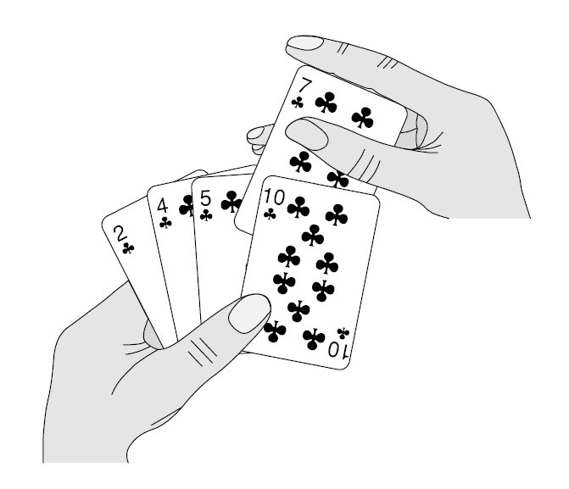
Insertion Sort
Its similar to arrangement of cards during card game

Slide 19
Insertion Sort
Insertion sort is implemented by inserting a particular data item in its proper position
Any unsorted data item is kept on swapping with its previous data items until its proper position is not found
The number of swapping makes the previous data items to shift for the new data item to take its position in order
Once the new data item is inserted, the next data item after it is chosen for next insertion
The process continues until all data items are sorted
This method is highly efficient if the list is almost in sorted form

Slide 20
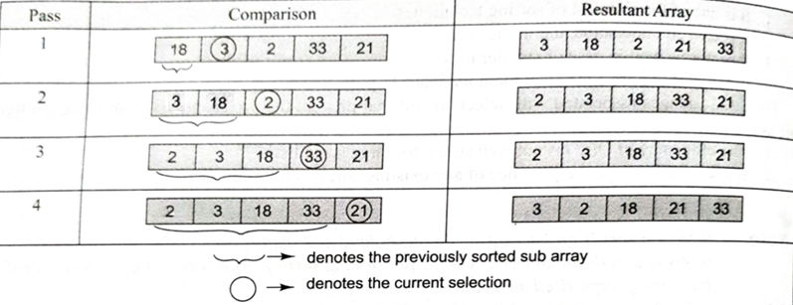
Insertion sort

Slide 21
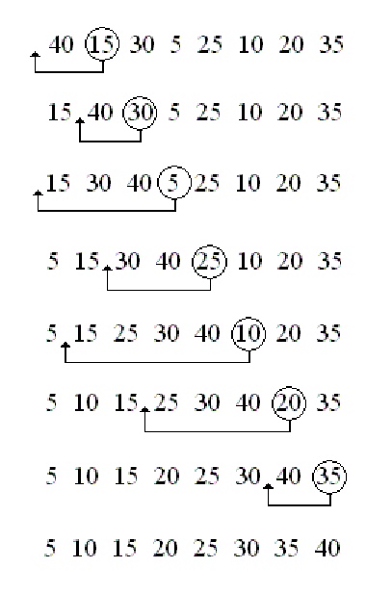
Insertion Sort

Slide 22

Insertion Sort

Slide 23
Insertion Sort (Algorithm-pseudocode)
INSERTION-SORT (ARR, N)
Step 1: Repeat Steps 2 to 5 for K = 1 to N–1
Step 2: SET TEMP = ARR[K]
Step 3: SET J = K - 1
Step 4: Repeat while TEMP <= ARR[J]
SET ARR[J + 1] = ARR[J] //SWAP
SETJ=J-1
[END OF INNER LOOP]
Step 5: SET ARR[J + 1] = TEMP
[END OF LOOP]
Step 6: EXIT

Slide 24
Quick Sort
Also called partition-exchange sort
Uses divide and conquer algorithm
One pivot element is chosen from within the list
The list is divided into two partition
All values less than the pivot are placed on left side of pivot
All greater values are placed on right side of the pivot
After a single pass, the pivot is in its proper position
The left and right partitions are sorted recursively using the same method joining the left sorted, pivot and right sorted results with the list in sorted order

Slide 25
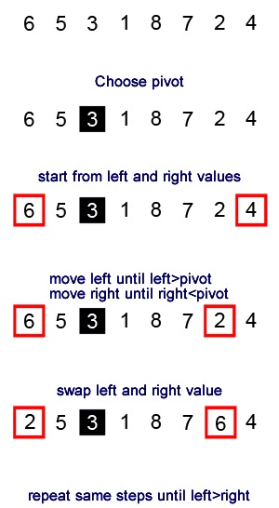
Quick Sort

Slide 26
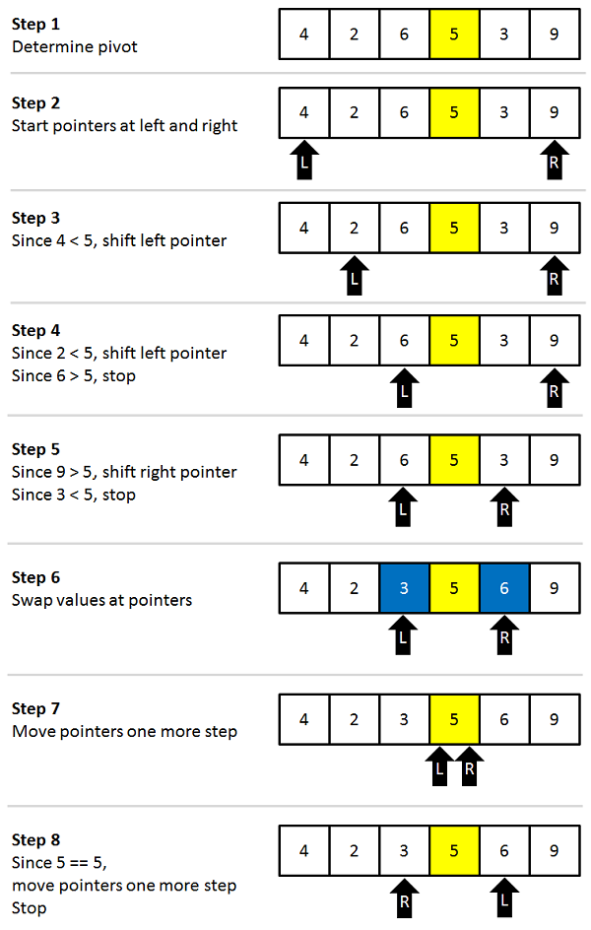
Quick Sort

Slide 27

Quick Sort

Slide 28
Quick Sort(Algorithm-pseudocode)
PARTITION (ARR, BEG, END, LOC)
Step 1: [INITIALIZE] SET LEFT = BEG, RIGHT = END, LOC = BEG, FLAG = 0
Step 2: Repeat Steps 3 to 6 while FLAG = 0
Step 3: Repeat while ARR[LOC] <= ARR[RIGHT] AND LOC != RIGHT
SET RIGHT = RIGHT - 1
[END OF LOOP]
Step 4: IF LOC = RIGHT
SET FLAG = 1
ELSE IF ARR[LOC] > ARR[RIGHT]
SWAP ARR[LOC] with ARR[RIGHT]
SET LOC = RIGHT
[END OF IF]
Step 5: IF FLAG =0
Repeat while ARR[LOC] >= ARR[LEFT] AND LOC != LEFT
SET LEFT = LEFT + 1
[END OF LOOP]
Step 6: IF LOC = LEFT
SET FLAG = 1
ELSE IF ARR[LOC] < ARR[LEFT]
SWAP ARR[LOC] with ARR[LEFT]
SET LOC = LEFT
[END OF IF]
[END OF IF]
Step 7: [END OF LOOP]
Step 8: END

Slide 29
Quick Sort(Algorithm-pseudocode)
QUICK_SORT (ARR, BEG, END)
Step 1: IF (BEG < END)
CALL PARTITION (ARR, BEG, END, LOC)
CALL QUICKSORT(ARR, BEG, LOC - 1)
CALL QUICKSORT(ARR, LOC + 1, END)
[END OF IF]
Step 2: END

Slide 30
Shell Sort
Generalization of insertion sort
Better form of insertion sort
Also called diminishing increment sort
A value for a gap(or increment) is chosen (convention: gap=n/2)
Sub-lists are made from the original list taking items from every gap values
The sub-lists thus formed are sorted first
In second pass smaller value for the gap is chosen (gap=gap/2)
The next sub-lists are formed and sorted
The process is repeated until gap value is less than 1; the list is sorted by the end of this pass

Slide 31
Shell Sort (Example)
Lets see an example
25, 57, 48, 37, 12, 92, 86, 33
We choose gap size of 5, 3, and 1
Original list
25, 57, 48, 37, 12, 92, 86, 33
Pass 1
Gap=5
25, 57, 48, 37, 12, 92, 86, 33
Pass 3
Gap=1
25, 12, 33, 37, 48, 92, 86, 57
Sorted
result
Pass 2
Gap=3
25, 57, 33, 37, 12, 92, 86, 48
12, 25, 33, 37, 48, 57, 86, 92

Slide 32
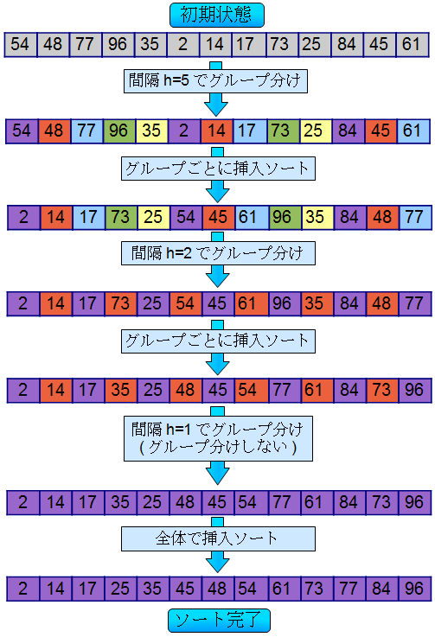
Shell Sort (Example)
Example 2
First Pass; Gap=5
After First Pass
Second Pass; Gap=2

Slide 33
Shell Sort (Example- contd..)
After Second Pass
Third Pass; Gap=1
This is our last pass
Final Sorted Output
Shell Sort Completed

Slide 34
Shell Sort (Algorithm-Pseudocode)
Shell_Sort(Arr, n)
Step 1: SET FLAG = 1, GAP_SIZE = N
Step 2: Repeat Steps 3 to 6 while FLAG = 1 OR GAP_SIZE>1
Step 3: SET FLAG = 0
Step 4: SET GAP_SIZE = (GAP_SIZE + 1) / 2
Step 5: Repeat Step 6 for I = toI<(N-GAP_SIZE)
Step 6: IF Arr[I + GAP_SIZE] > Arr[I]
SWAP Arr[I + GAP_SIZE], Arr[I]
SET FLAG = 0
Step 7: END

Slide 35
Merge Sort
It is a divide and conquer algorithm
At first we divide the given list of item
list is divided into two parts from middle
The process is repeated until each sub-list contain exactly 1 item
Now is the turn for sort and combine (conquer)
A list with a single element is considered sorted automatically
Pair of list is sorted and merged into one (i.e. approx. n/2 sublists of size 2)
The sort and merge is keep on repeated until a single list of size n is found
The overall dividing and conquering is done recursively

Slide 36
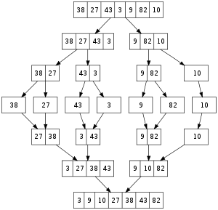
Merge Sort
Divide
Conquer

Slide 37
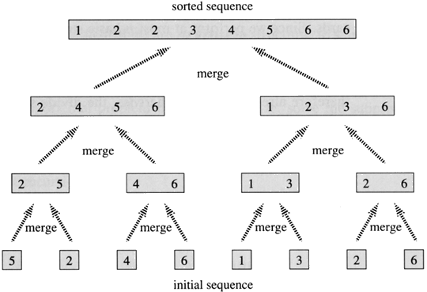
Merge Sort
Bottom-Up approach of merge after
completion of division

Slide 38
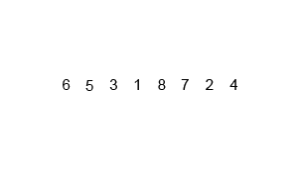
Merge Sort

Slide 39
Merge Sort
To sort A[p .. r]:
1. Divide Step
If a given array A has zero or one element, simply return; it is already sorted.
Otherwise, split A[p .. r] into two sub-arrays A[p .. q] and A[q + 1 .. r], each containing about half of the elements of A[p .. r]. That is, q is the halfway point of A[p .. r].
2. Conquer Step
Conquer by recursively sorting two subarrays A[p .. q] and A[q + 1.. r].
3. Combine Step
Combine the elements back in A[p .. r] by merging the two sorted subarrays A[p .. q] and A[q + 1 .. r] into a sorted sequence.
To accomplish this step, we will define a procedure MERGE (A, p, q, r).

Slide 40
Merge Sort (Algorithm)
Declare and initialize necessary variables
n-total number of elements in an array
a[n]-array containing data
p=0, r=n-1; first and last index of the array
MERGE-SORT (A, p, r)
1. IF p < r // Check for base case
2. THEN q = (p + r)/2 // Divide step
3. MERGE-SORT (A, p, q) // Conquer step.
4. MERGE-SORT (A, q + 1, r) // Conquer step.
5. MERGER (A, p, q, r) // combine step.

Slide 41
Merge Sort (Algorithm-pseudocode)
MERGE_SORT(ARR, BEG, END)
Step 1: IF BEG < END
SET MID = (BEG + END)/2
CALL MERGE_SORT (ARR, BEG, MID)
CALL MERGE_SORT (ARR, MID + 1, END)
MERGE (ARR, BEG, MID, END)
[END OF IF]
Step 2: END

Slide 42
MERGE (ARR, BEG, MID, END)
Step 1: [INITIALIZE] SET I = BEG, J = MID + 1, INDEX =0
Step 2: Repeat while (I <= MID) AND (J<=END)
IF ARR[I] < ARR[J]
SET TEMP[INDEX] = ARR[I] , SETI=I+1
ELSE
SET TEMP[INDEX] = ARR[J] , SETJ=J+1
[END OF IF]
SET INDEX = INDEX + 1
[END OF LOOP]
Step 3: [Copy the remaining elements of right sub-array, if any]
IFI>MID
Repeat while J <= END
SET TEMP[INDEX] = ARR[J] , SET INDEX = INDEX + 1, SET J = J + 1
[END OF LOOP]
[Copy the remaining elements of left sub-array, if any]
ELSE
Repeat while I <= MID
SET TEMP[INDEX] = ARR[I] , SET INDEX = INDEX + 1, SET I = I + 1
[END OF LOOP]
[END OF IF]
Step 4: [Copy the contents of TEMP back to ARR] SET K= 0
Step 5: Repeat while K < INDEX
SET ARR[K] = TEMP[K] ,SETK=K+1
[END OF LOOP]
Step 6: END

Slide 43
Radix Sort
Non-comparative integer sorting algorithm
Queues are made for representing different key values
In each queue sub-lists from the original list are formed depending on the key values
The data to be sorted in the given list is checked starting from any of the position(LSD/MSD) in data
If the starting position is LSD – Least Significant Digit, then the sorting is called LSD Radix Sort
If the starting position is MSD – Most Significant Digit, then the sorting is called MSD Radix Sort
The corresponding LSD or MSD value determines the queue for the data items

Slide 44
Radix Sort
All the values are made of same length by adding 0s as MSDs if any of the values is shorter than others
If LSD is being used, one’s position are checked first and sub-lists are formed
Sub-lists are now gathered into main list in order of the key values in queues
Thus formed list is now again checked for ten’s place and sub-lists are formed on queues
The gathering and forming of sub-lists is continued for other higher placed digit until every queue contains at most one data items
Now the final gathering results with the sorted list

Slide 45
Radix Sort
LSD Radix Sort is mainly used for sorting Numeral values
MSD Radix Sort is mainly used for sorting Alphabetical values
Its main advantage is that the computers represent data in binary form which can be sorted easily by using radix sort
Its main disadvantage is that it requires more space than other sorting algorithms

Slide 46
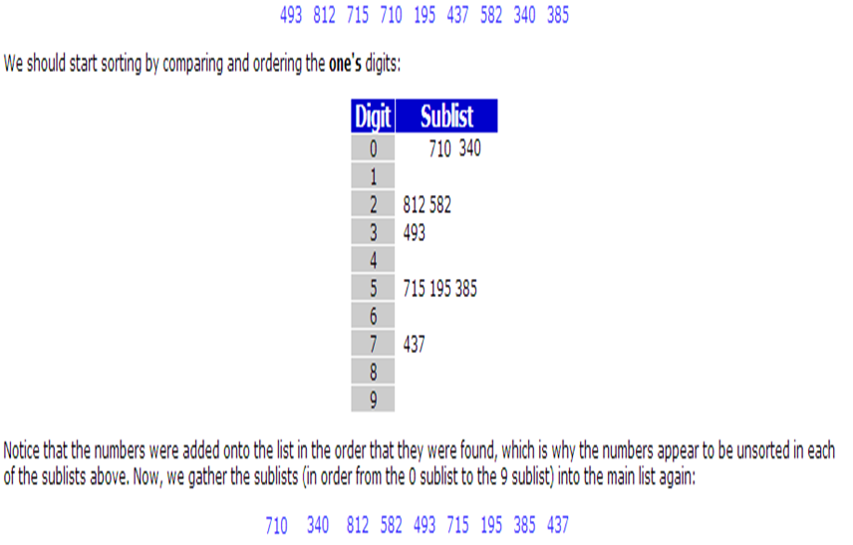
Radix Sort (Example)

Slide 47
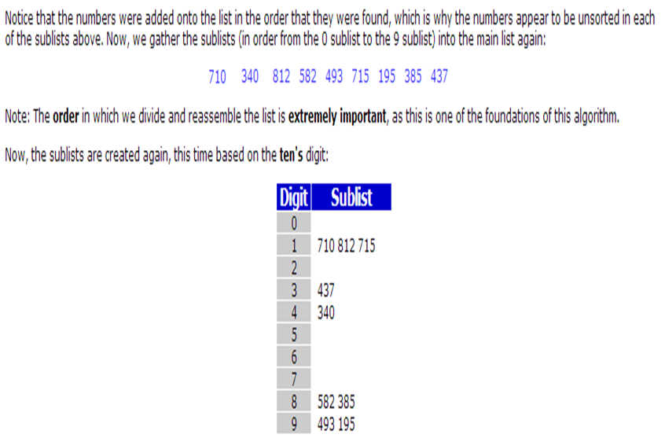
Radix Sort (Example)

Slide 48
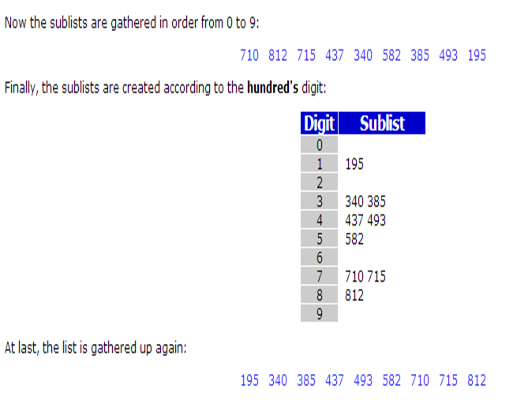
Radix Sort (Example)

Slide 49
Radix Sort (Algorithm-pseudocode)
RadixSort (ARR, N)
Step 1: Find the largest number in ARR as LARGE
Step 2: [INITIALIZE] SET NOP = Number of digits in LARGE
Step 3: SET PASS = 0
Step 4: Repeat Step 5 while PASS <= NOP-1
Step 5: SET I= and INITIALIZE buckets
Step 6: Repeat Steps 7 to 9 while I<N-1
Step 7: SET DIGIT = digit at PASS^{th} place in A[I]
Step 8: Add A[I] to the bucket numbered DIGIT
Step 9: INCEREMENT bucket count for bucket numbered DIGIT
[END OF LOOP]
Step 10: Collect the numbers in the bucket
[END OF LOOP]
Step 11: END

Slide 50
Heap
Heaps are almost complete binary tree, where
Content of each node is less than or equal to that of its father
All levels are full except the lowest level
If lowest level is not full, then nodes must be packed to left
The operations performed in a heap tree are: insertion and deletion
Insertion always occurs in empty left child node
Deletion occurs from root node
Note: There should not be any gap in a heap tree

Slide 51
Operations in Heap
Insertion in the heap
Add new element to the lowest available level
Check the newly inserted value with the value in its parent node
If the parent value is less than the child node
Then interchange the values of child and parent
Repeat the comparison and interchange with other ascending nodes for the condition above
Keep on repeating the above processes until all data are inserted
Note: the process of changing the node with its parent is called heapup

Slide 52
Operations in Heap
Deletion from heap
Remove the root element
Move the last node onto the root node
Check the value with child node and swap until it gets its proper position
During swapping the parent node is swapped with the greater child among the two children
Note: Process of changing the node with its child is called heapdown

Slide 53
Heap Sort
Comparison based sorting algorithm
One of the types of selection sort
It is an in-place algorithm
It is not a stable sort
Heap sort algorithm is divided into two-parts
Building of heap
Sorting of data in an array from the heap

Slide 54
Heap Sort
The two steps for sorting are:
In the first step,
a heap is built out of the data.
In the second step,
a sorted array is created by using following technique
repeatedly remove the largest element from the heap,
Insert it into the array.
Reconstruct the heap after each removal.
Once all objects have been removed from the heap, we have a sorted array.

Slide 55
Heap Sort (Algorithm)
Construct a heap using the data from the list by inserting every data sequentially
After the completion of heap construction, create an array with its bound equal to number of elements in the heap
Remove root value from heap and insert it into array
Insert the value of last node into the place of root
Reconstruct the heap by arranging the data (reheapdown)
Continue the above steps until all nodes are deleted from heap and inserted into the array
Now the array contains the result in sorted form

Slide 56
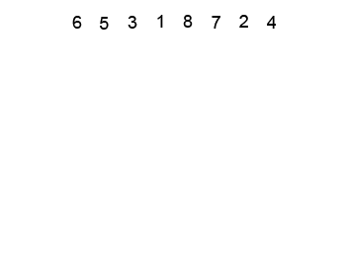
Heap Sort (Example)

Slide 57
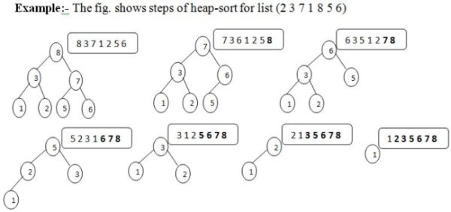
Heap Sort

Slide 58
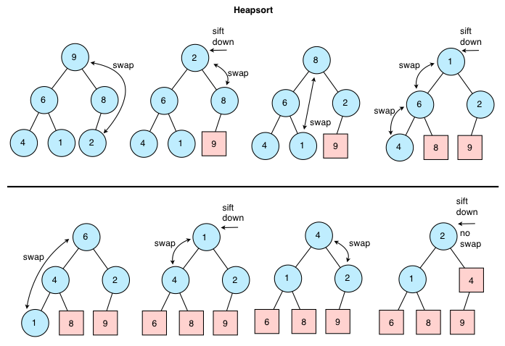
Heap Sort

Slide 59
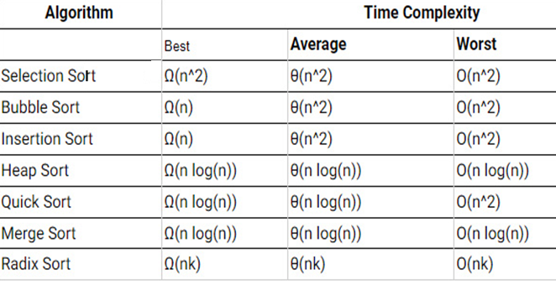
Efficiency of sorting algorithms

Slide 60
THANK YOU!

